Slide 1

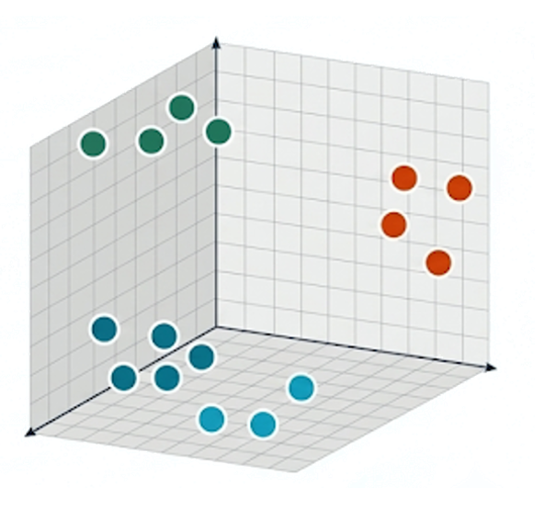

Learning
Community
Vectors
Notes:
When Chris asked if I wanted to do power first method was maybe. So I looked back at last year's sequel bits grintspiration. When I think of siquette I think about community and learning. APart from this one hour power of course.
I also thought back to the key note and SQL 25 and vector data types
So I racked my head to think of a good idea that will combine all of these things. I didn't want to just do a regular vector rag application type demo.

Slide 2
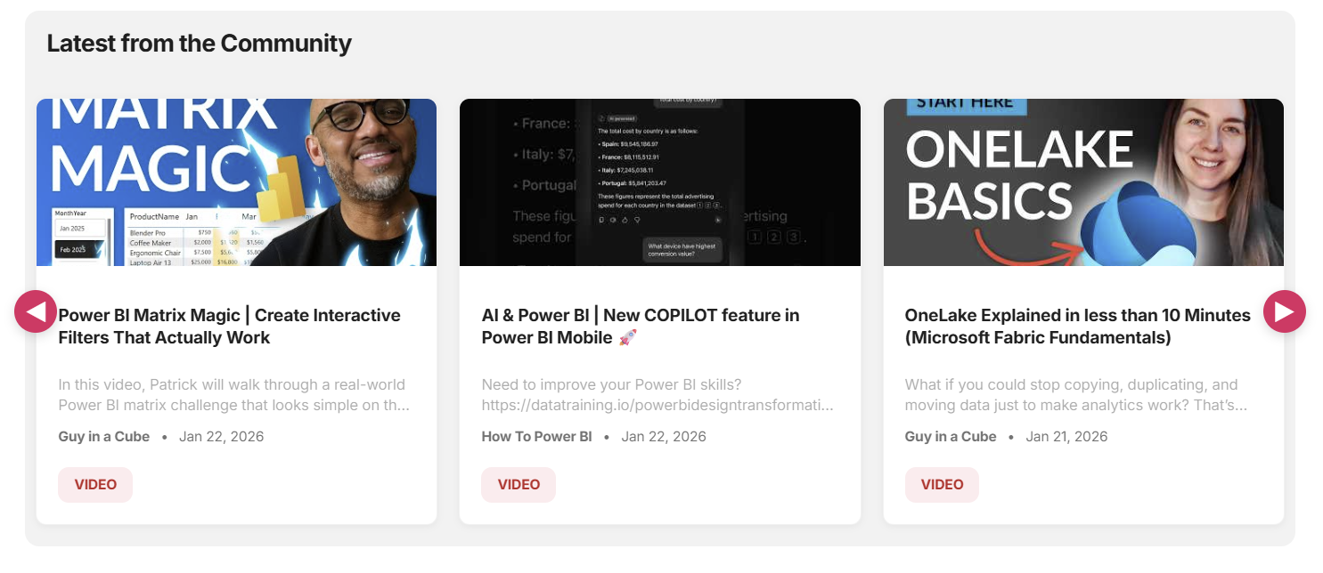

Notes:
Like and get personalized feed

Slide 3
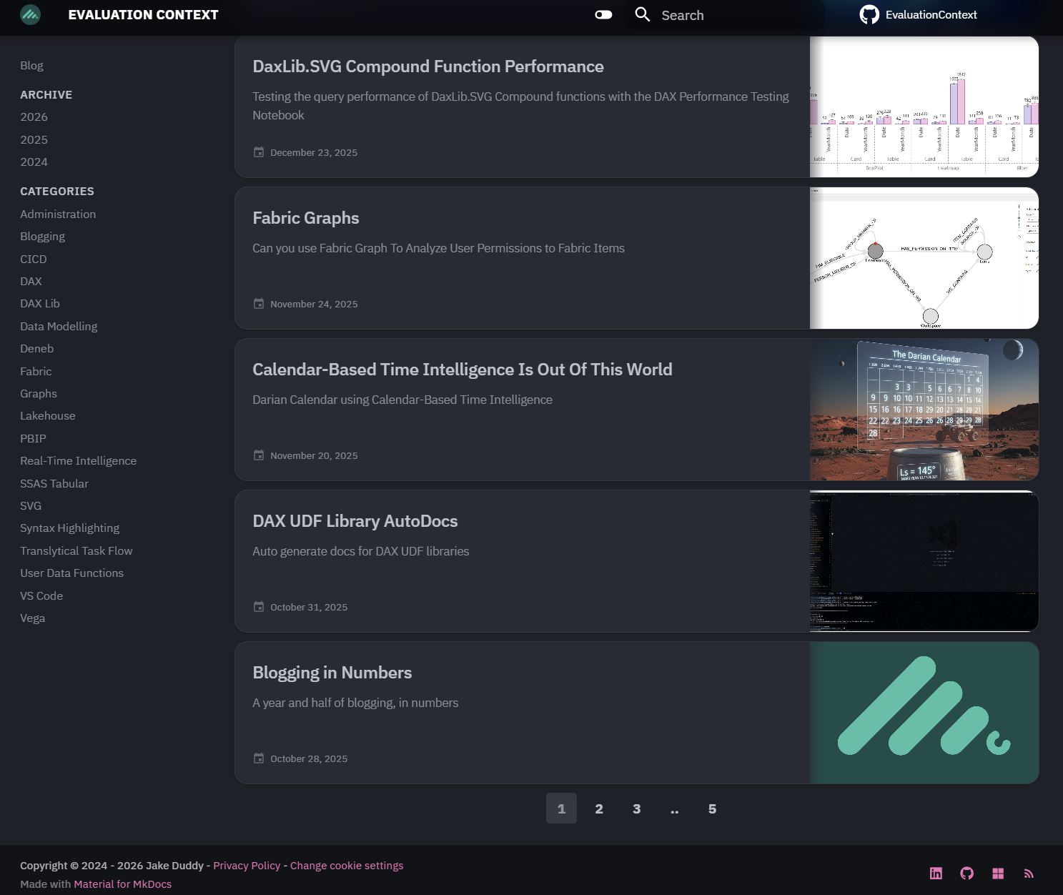


Slide 4
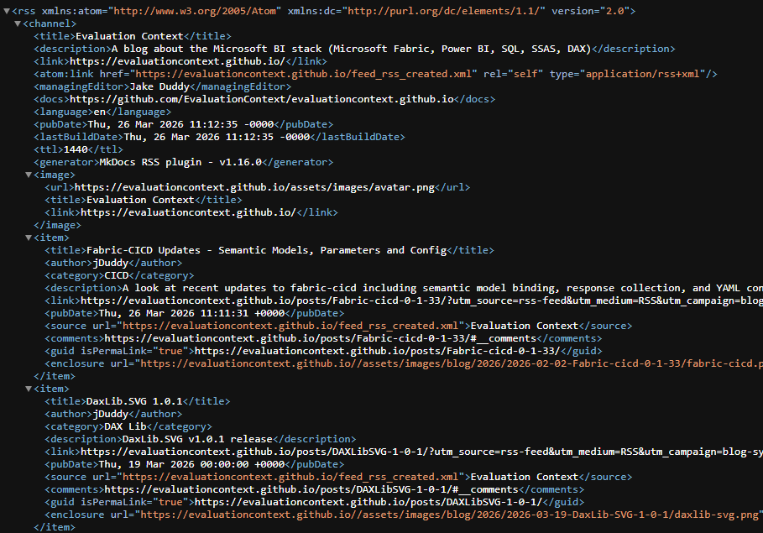
Channel Info
Item 1
Item 2

Slide 5

Input
Vector
Embedding
Vector
Database
Notes:
Normally for RAG/search

Slide 7

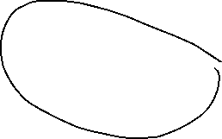


Slide 8
